Slide 1
Data Decoy Milestone 2
Denise Blady
Brian Rosenberg
Guru Prasad
Eric Lehner

Slide 2
Milestone 2
Support Selective Mocking through
Improvement of the UI
Show which applications are mocked and set how you would like to mock it
Improvement of the LocationManager patch
Make a more believable mocked algorithm
Add selective mocking support

Slide 3
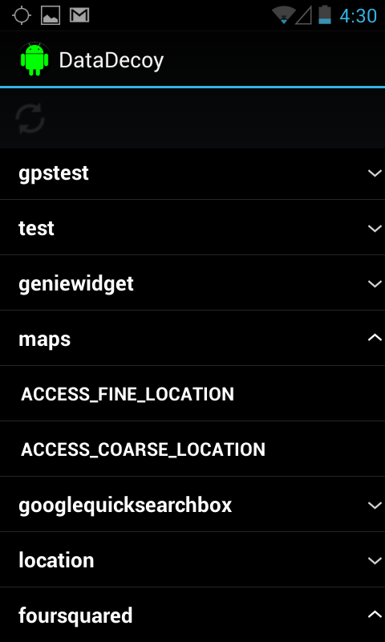
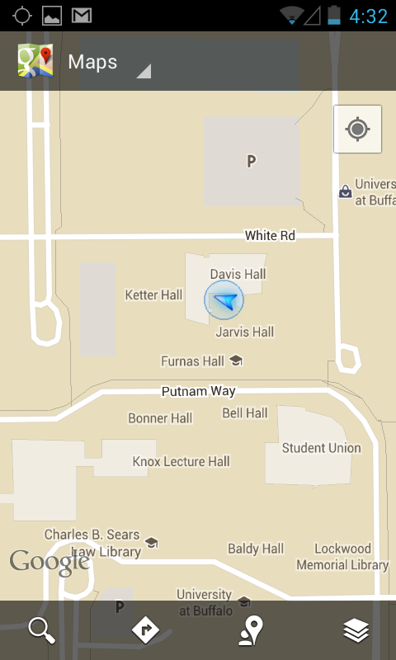
Data Decoy UI – Not mocked

Slide 4
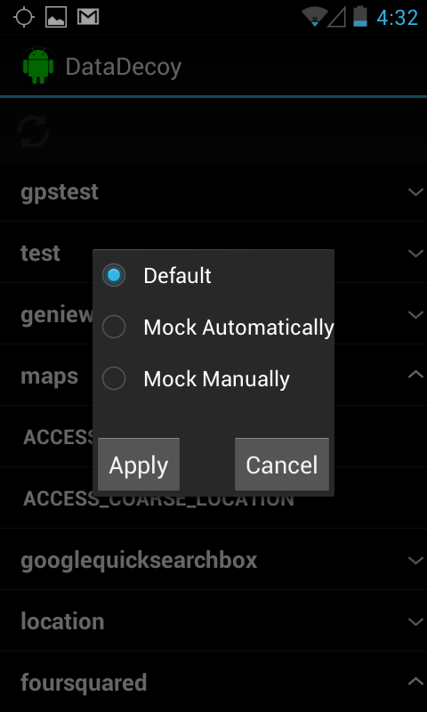
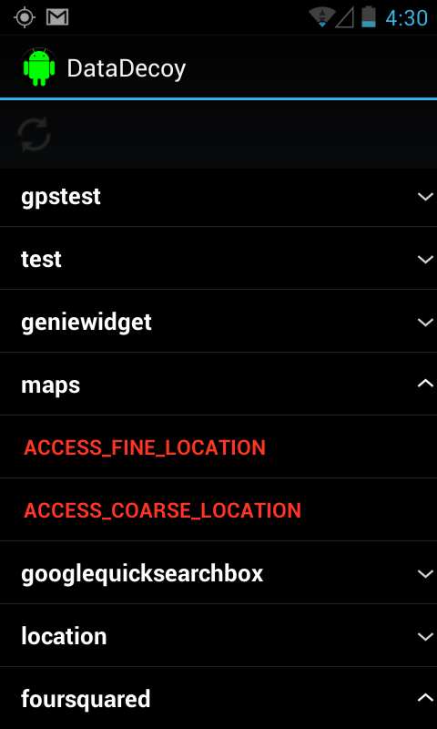
Data Decoy UI - Mocked

Slide 5
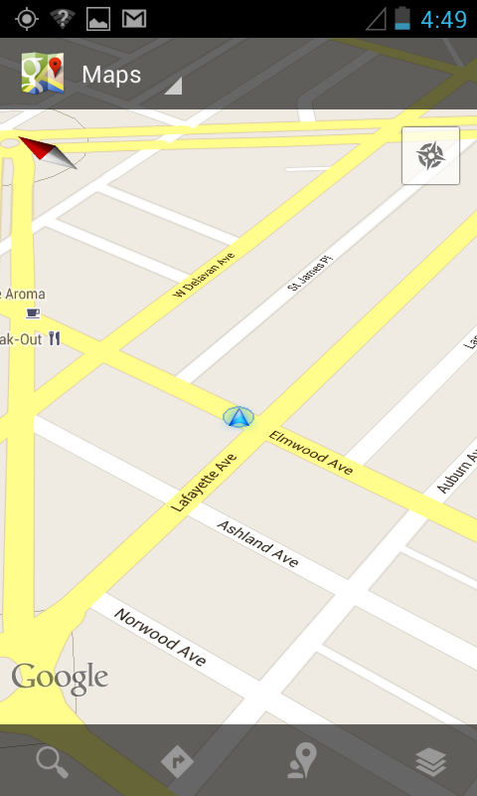
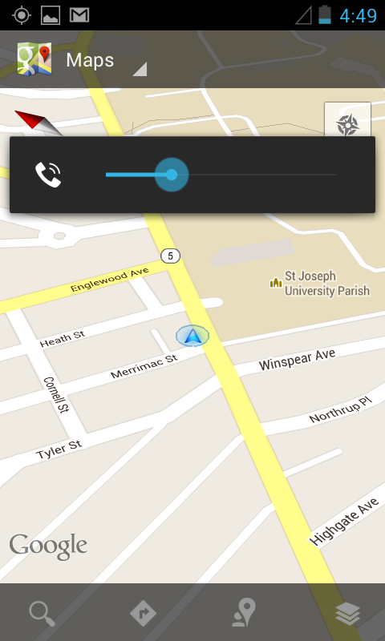
Data Decoy UI- Mocked

Slide 6
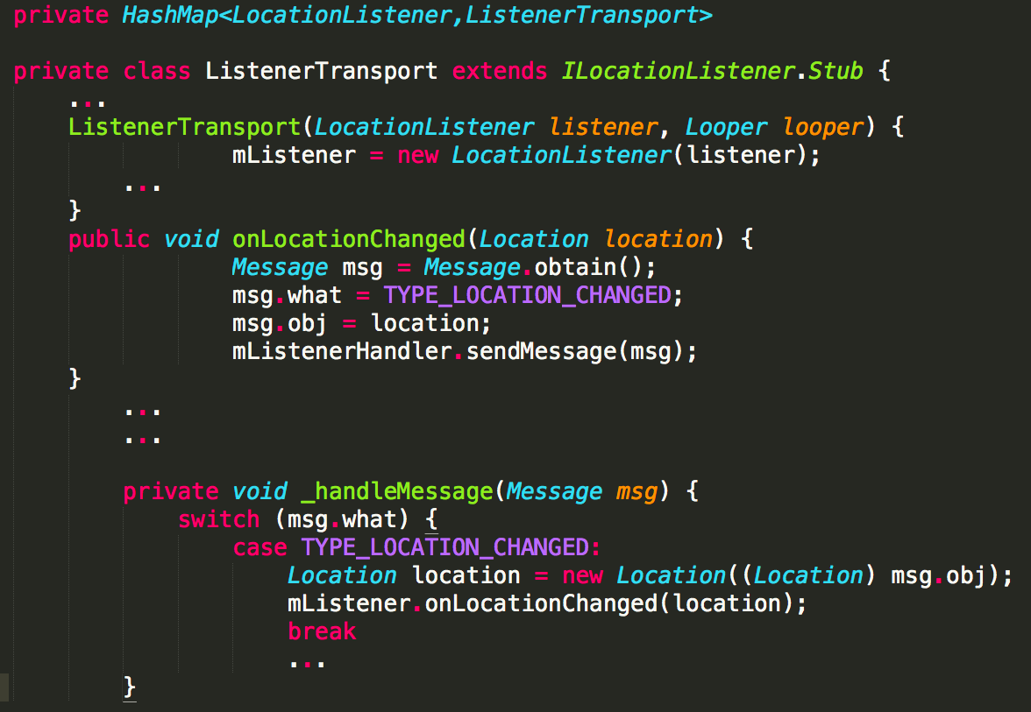
LocationManager

Slide 7


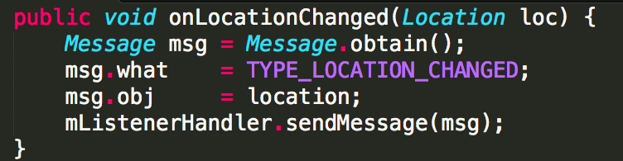
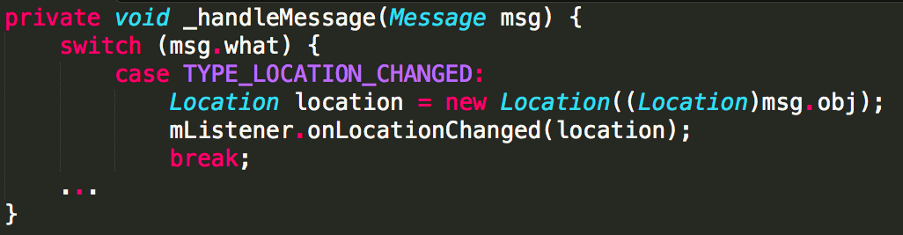
Location loc

Slide 8
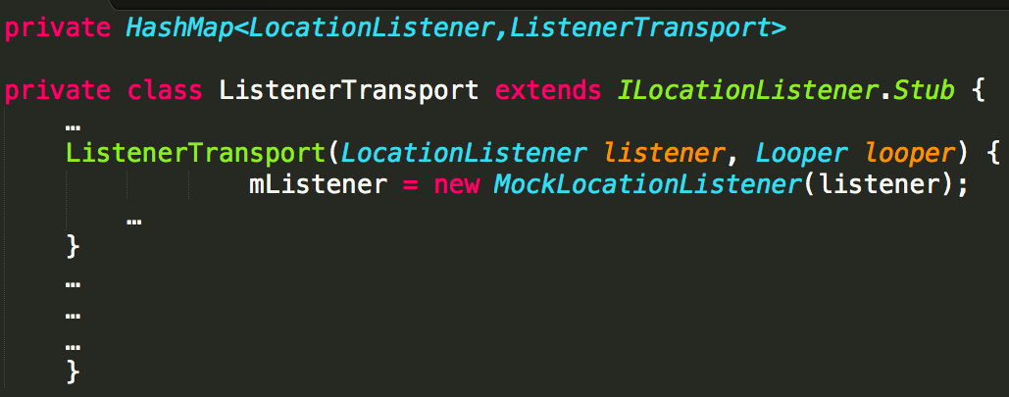
LocationManager

Slide 9

Location loc

Slide 10
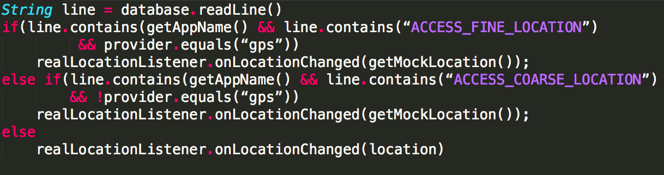
The Magic Pseudo code of ((MockLocationListener) LocationListener).onLocationChanged(Location location)

Slide 11
Next Milestone
Finish the UI
Debug
Optimize and improve
Usability for average user
Make it easier to input mocked locations
Currently working on a map widget
Finish the Patch
Debug

